Slide 1
UA-Coding Bootcamp Project 1 Cinema Symphony
Jenny Le, William Crocker, Srdjan Markovich

Slide 2
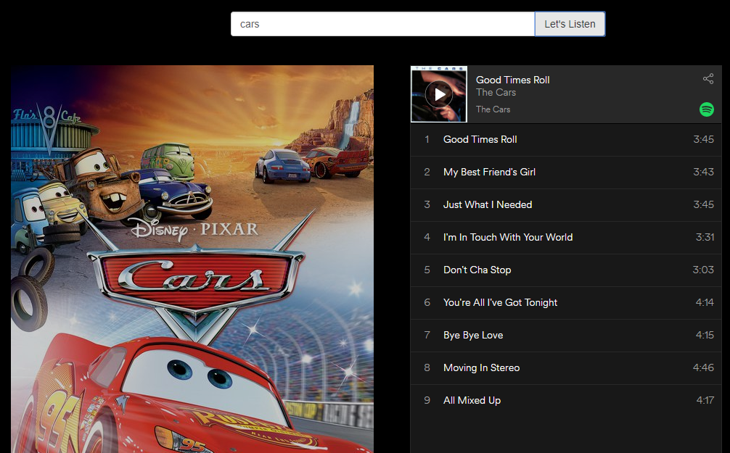
Cinema Symphony
Search engine for movies and music
Search for title and displays movie and list of the songs

Slide 3


Feel free to add Will

Slide 6

End
Questions

